Slide 1

Revolutionizing Job Applications:
Journey Towards Standout Resumes
Presented by:
Xuehao Zhang
Jiayong Lu
Duc Viet Mai
Yi Xu
Shurui Jiang
Assisted by:
Dr. Shachi Winton

Slide 2
Table of Content
Introduction
overview
business problem
Target Industries
Demographics and Experience Levels
Experience and Skills Trends
Resume Metrics and Analysis
CoverQuick's Value Proposition
Conclusion

Slide 3
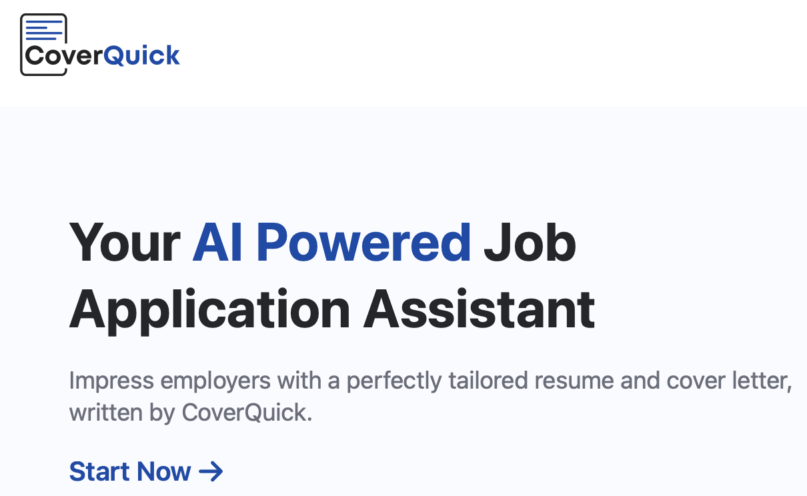
Overview of CoverQuick
Utilizes AI technology to help job seekers create personalized & professional resumes and cover letters
Select the type of documents and add job descriptions to generate cover letters for specific job applications

Slide 4
Business Problem
Deliverable 1
Find 2 to 3 target industries that most of our users apply to.
Deliverable 2
Discover trends in demographics and find which industries yield the best and the worst resumes.
Deliverable 3
Determine trends in experience and skills for these target users.
Deliverable 4
Determine the approximate age range and experience level.

Slide 5
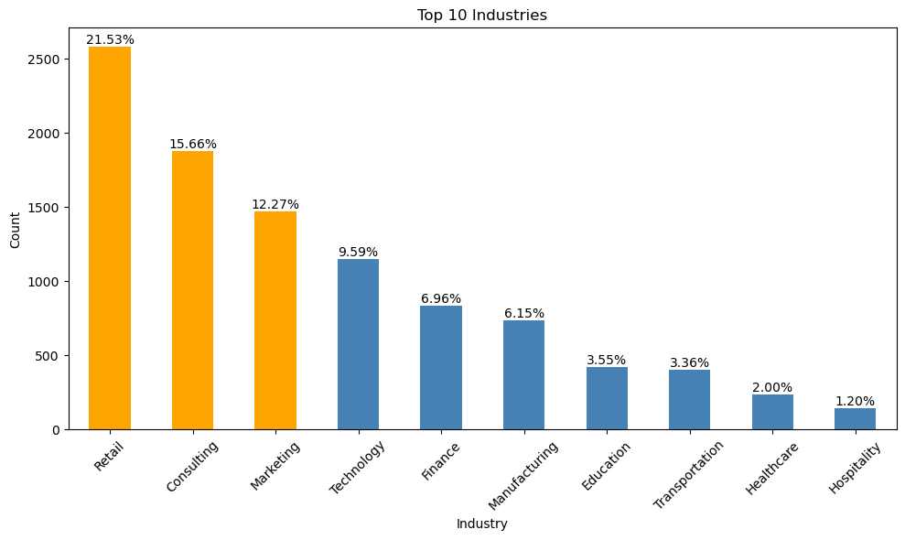
Target Industries
Retail, Consulting, Marketing
Top three topics:
1.Topic 15: job, system, tracking, applicant, description
2.Topic 3: customer, service, experience, support, product
3.Topic 7: training, management, hr, development, learning

Slide 6
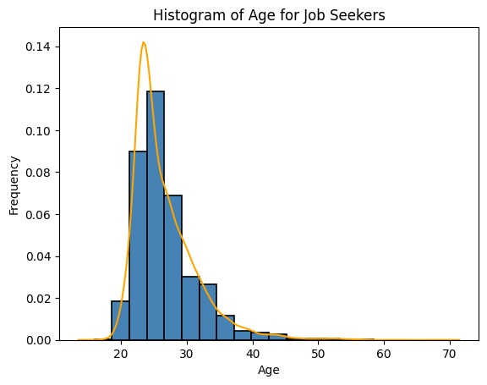
Demographics and Experience Levels - Age Range
Age from 18 to 45
Majority: age from 23 to 27

Slide 7
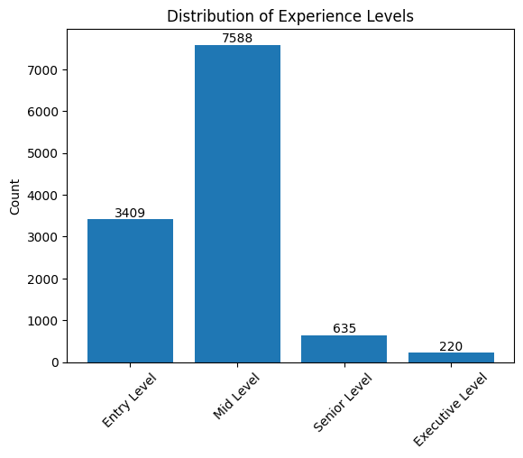
Demographics and Experience Levels - Experience Level
Majority: Middle level in experience

Slide 8
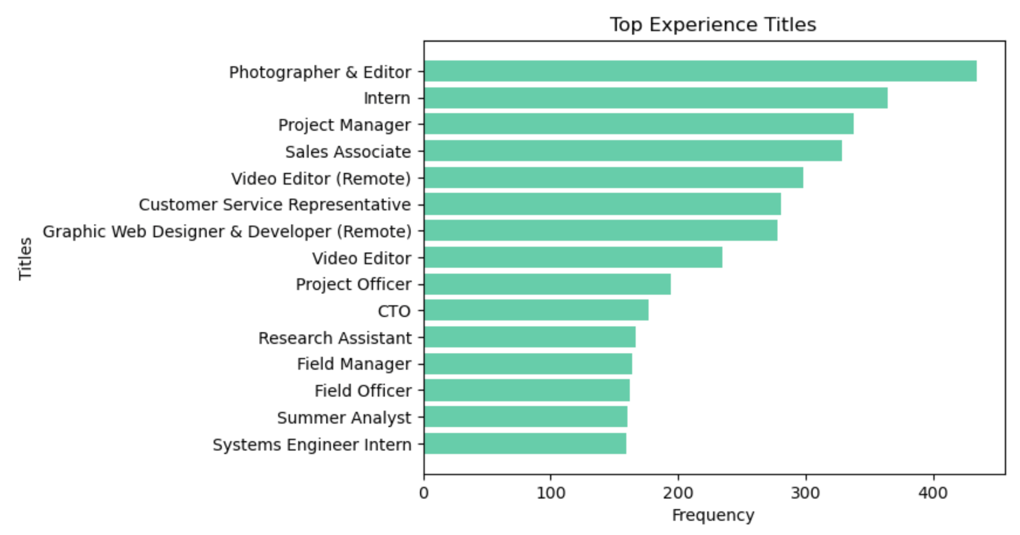
Experience and Skills Trends - Experience Title
Photographer & Editor
Intern
Project Manager

Slide 9
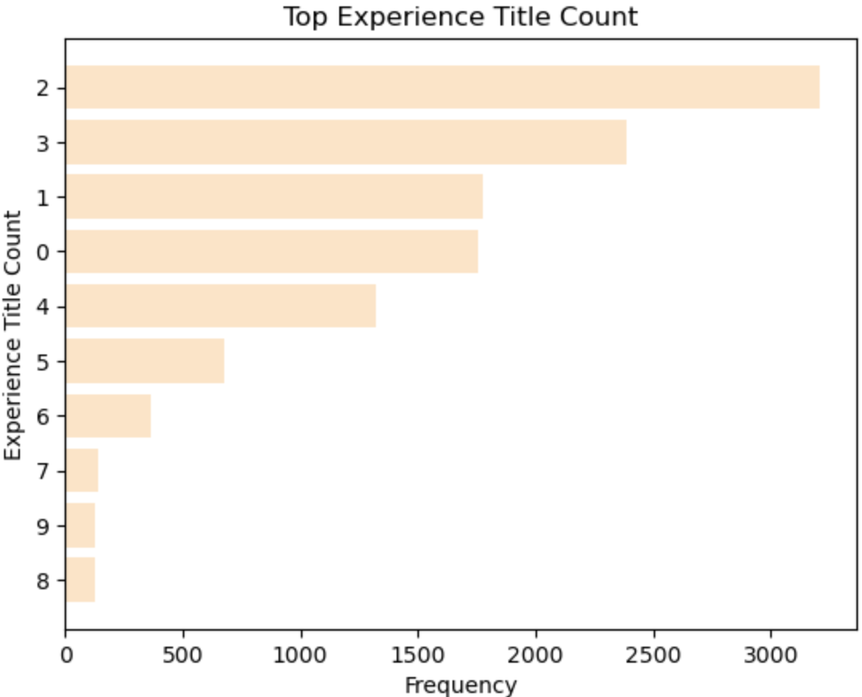
Experience and Skills Trends - Experience Title Count
Majority: 2 experience titles

Slide 10
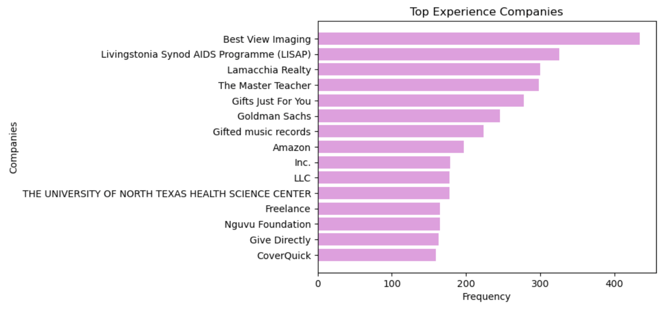
Experience and Skills Trends - Experience Companies
Best View Imaging, Livingstonia Synod AIDS Programme (LISAP), Lamacchia Realty

Slide 11
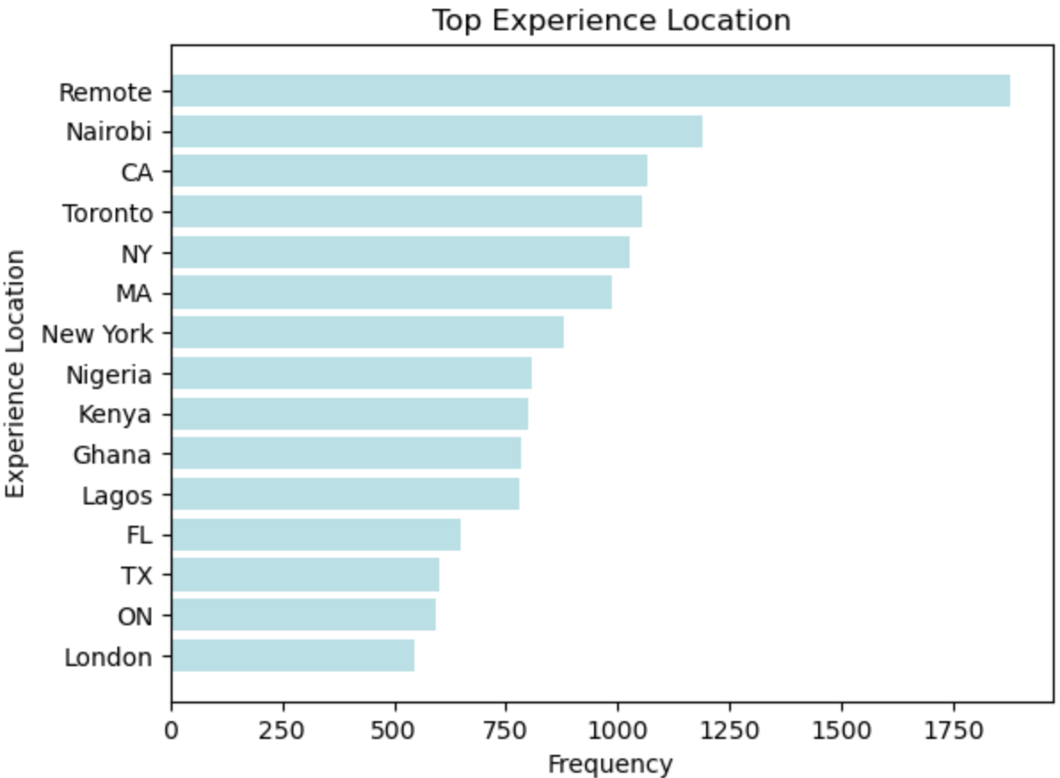
Experience and Skills Trends - Experience Location
Remote, Nairobi, CA

Slide 12
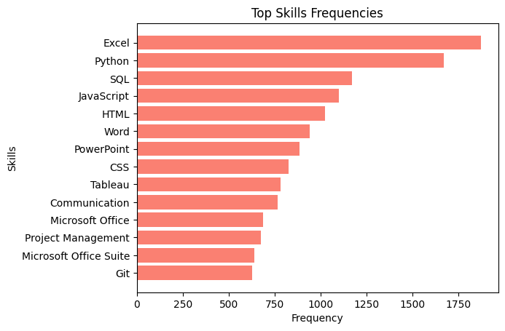
Experience and Skills Trends - Skills
Excel
Python
SQL
JavaScript
HTML

Slide 13
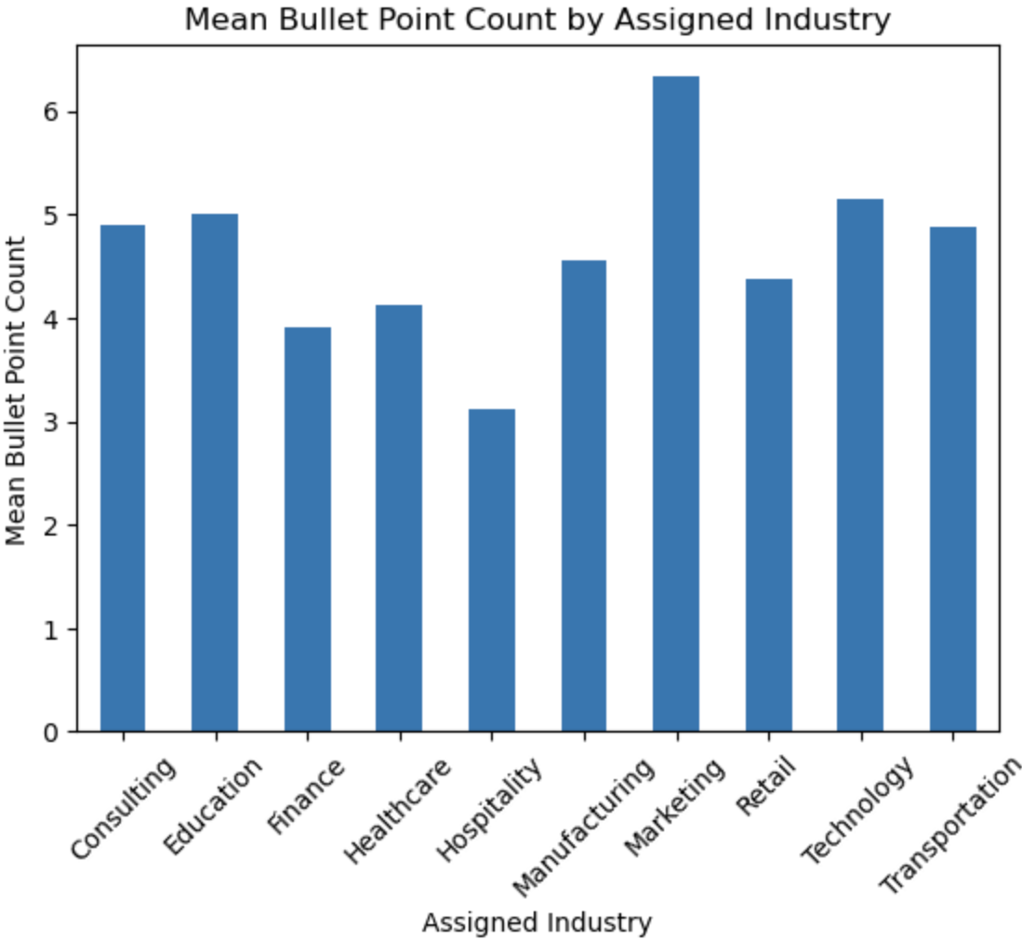
Resume Metrics and Analysis - Excessive Bullet Point
Assigned Industries:
Marketing
Technology
Education

Slide 14
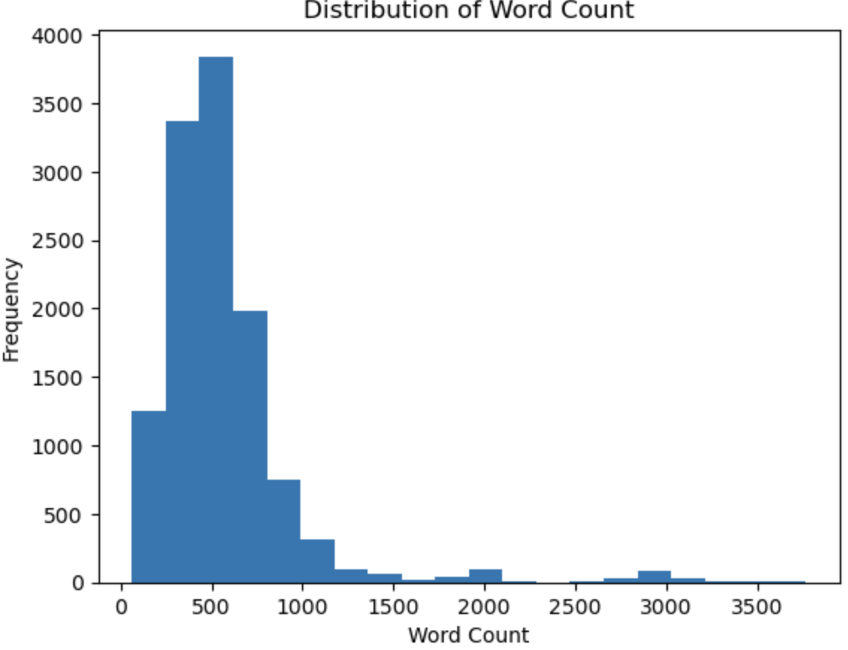
Resume Metrics and Analysis - Word Count
Majority: 500 words

Slide 15
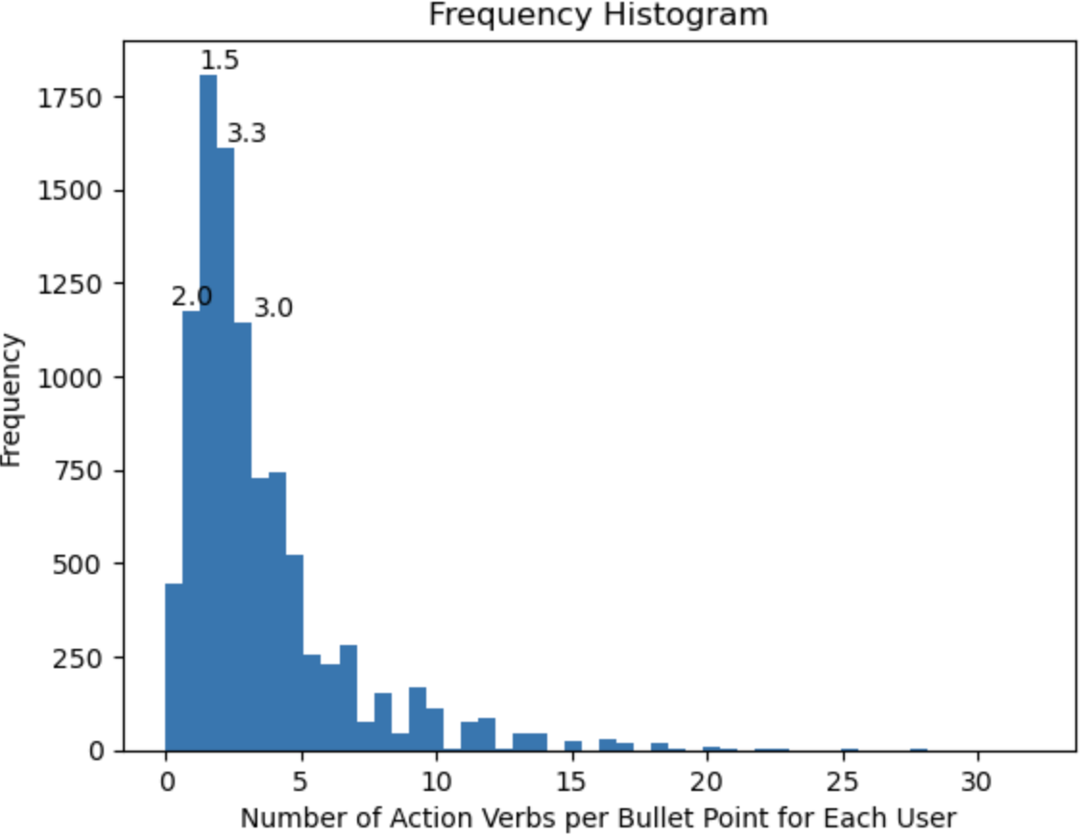
Resume Metrics and Analysis - Use of Action Verbs
Approximate 2 action verbs appear in each bullet point

Slide 16
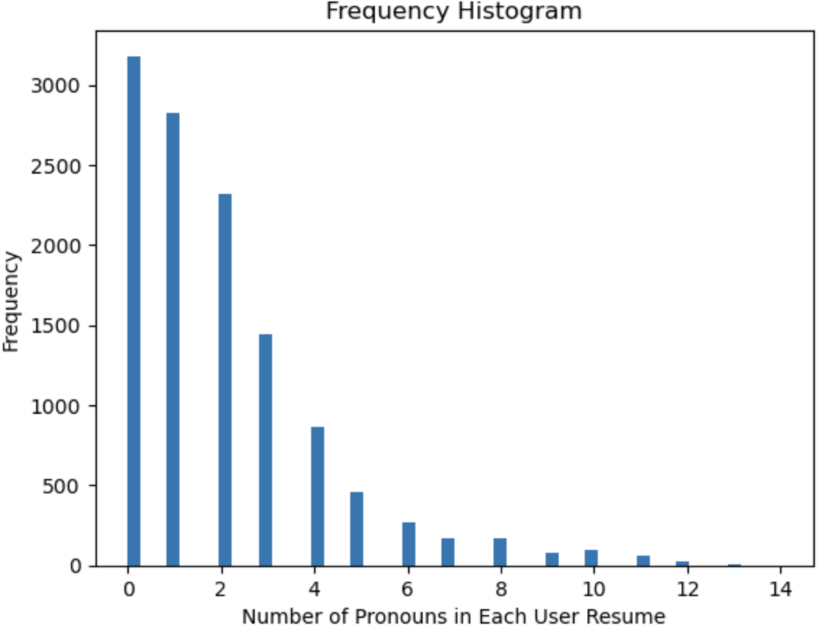
Resume Metrics and Analysis - Use of Pronouns
Majority of using pronouns:
0 to 2

Slide 17
CoverQuick's Value Proposition
CoverQuick offers helpful tips and resources for crafting effective resumes and cover letters, including sample phrases and keywords to include.

Slide 18
Conclusion and Next Steps
To address the limitations or weaknesses of the dataset, it may better to consider collecting more diverse data from a wider range of sources.
i.e. from different job titles, industries, and locations, as well as data from a more diverse range of demographics
To better implement more rigorous data-cleaning processes to identify and correct biases in the data. It may better to conduct regular audits of the data to ensure that the generated documents are accurate and free of biases.
Using these statistical insights to improve CoverQuick's services and enhance the user experience.

